Slide 1

FINAL PROJECT
Machine Learning

Slide 2

Machine learning MODELS Used:
Linear Regression
Logistic Regression
Decision Tree
Random Forest
K-Nearest Neighbors (KNN)
K-Means Clustering
Support Vector Machine (SVM)

Slide 3
ASSESSMENT-1
PROBLEM STATEMENT :
Dataset contains the information of Customer price index, discounts, offers where the organization wants to predict the sales based on the cpi, discounts, offers.
Model Used : Linear Regression
R2_Score : 0.9517053277318956
Find out the Sales that has
5000 cpi , 3 percentage discounts, 20 rewards offers
4000 cpi , 8 percentage discounts, 19 rewards offers

Slide 4
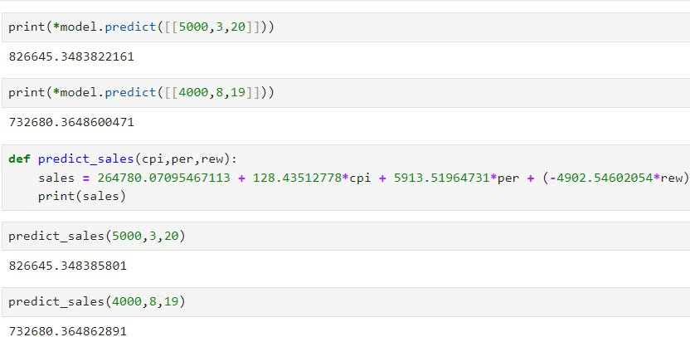
PREDICTION :
Sales for 5000 cpi , 3 percentage discounts, 20 rewards offers : ₹ 826645
Sales for 4000 cpi , 8 percentage discounts, 19 rewards offers : ₹ 732680

Slide 5
ASSESSMENT-2
PROBLEM STATEMENT :
Dataset contains the bank details of customer – need to predict the how we can offer loan to customer based on the cybill score, Age, insurance, debit card , cards.
Model Used : Logistic Regression

Slide 6
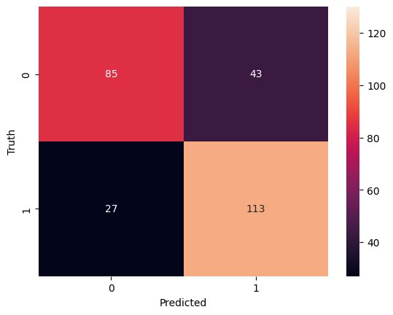
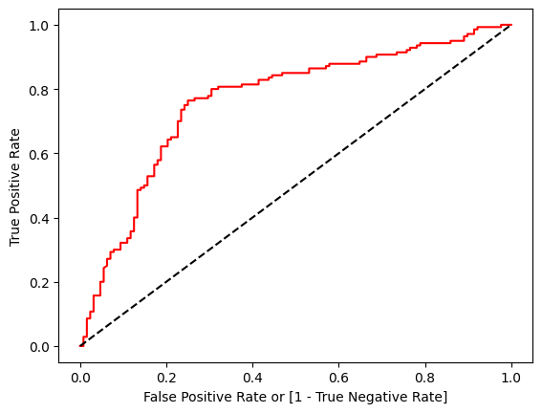
CONFUSION MATRIX :
ROC – Curve :
Accuracy Score : 0.7388059701492538
( 73.88 % )

Slide 7
ASSESSMENT-3
Problem Statement :
Dataset contains the information of customer and their geographical and personal details , Build the classification models like Decision Tree , Random forest , KNN , k-Means and SVM to classify the data in to proper groups
Models Used :
Decision Tree
Random Forest
K-Nearest Neighbors
K-Means Clustering
Support Vector Machine

Slide 8
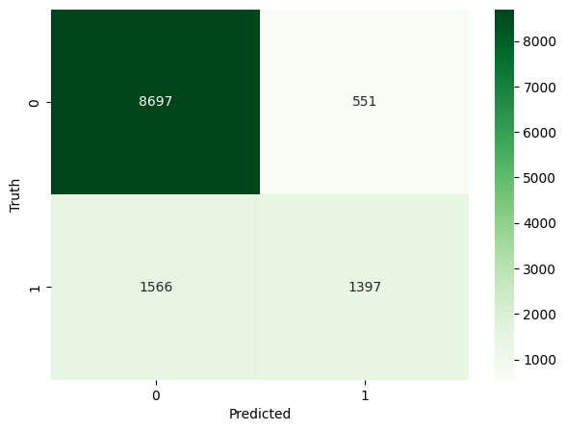
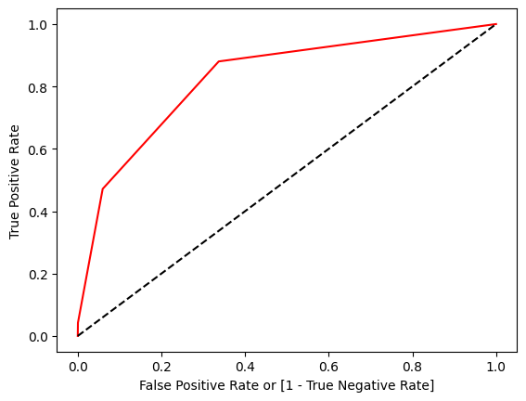
DECISION TREE
Confusion Matrix :
ROC - Curve :
Accuracy Score : 0.8266317254934076
( 82.6 % )

Slide 9
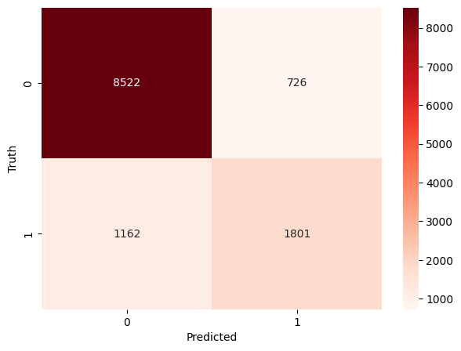
RANDOM FOREST CLASSIFER
Confusion Matrix :
ROC - Curve :
Accuracy Score : 0.8453853083285562
( 84.5 % )

Slide 10
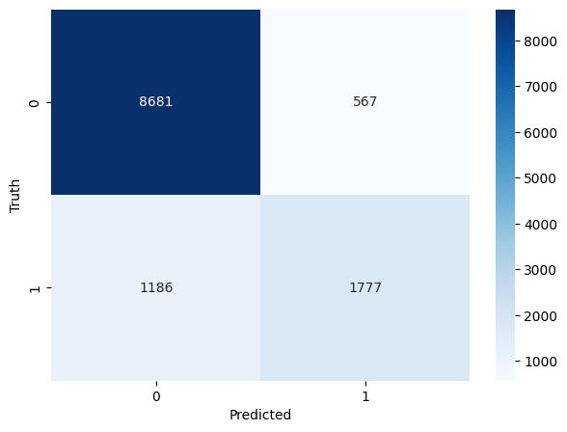
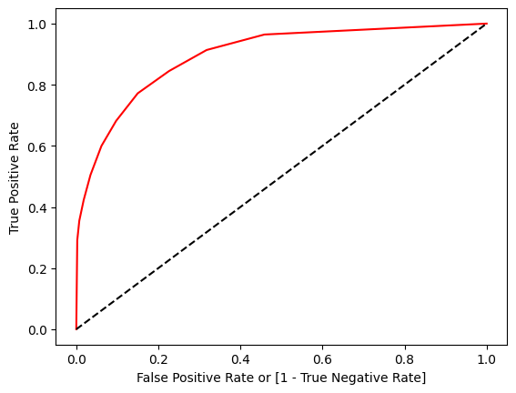
K-Nearest Neighbors
Confusion Matrix :
ROC - Curve :
Accuracy Score : 0.856440913930063
( 85.6 % )

Slide 11
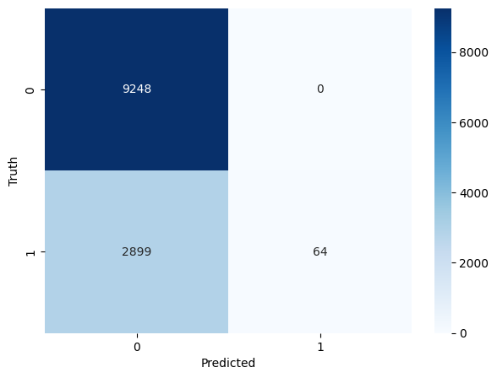
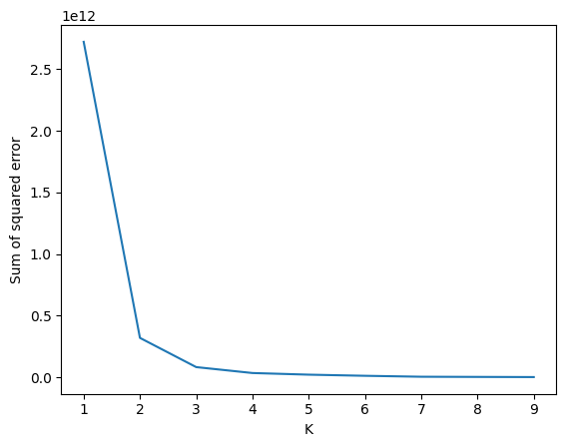
K-Means Clustering
Confusion Matrix :
Elbow Plot :
Accuracy Score : 0.7625911063794939
(76.25 % )

Slide 12
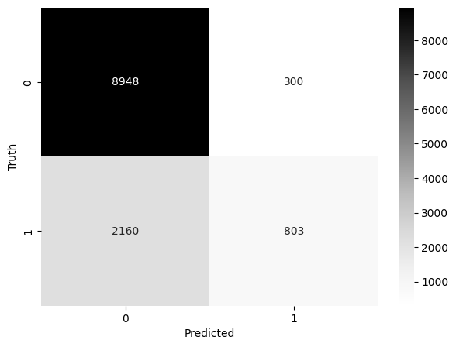
SVM
Confusion Matrix :
ROC - Curve :
Accuracy Score : 0.7985422979280976
( 79.8 % )

Slide 13
CONCLUSION ON ASSESSMENT - 3 :
MODEL | ACCURACY SCORE
DECISION TREE | 82.6 %
RANDOM FOREST | 84.5 %
KNN | 85.6 %
K-Means Clustering | 76.25 %
SVM | 79.8 %
From the above table, We can clearly see KNN model has performed better with higher Accuracy Score ( 85.6 %) followed by RANDOM FOREST ( 84.5 %) and Decision Tree ( 82.6 %)

